Slide 1
BANK LOAN prediction
By : JANHAVI ARUN PATOLE

Slide 2
Aim and Objective
The objective of bank loan prediction is to accurately assess whether loan applicants are likely to repay the loan or default, helping banks minimize risk and make informed lending decisions.
The Aim of the project is To develop a predictive model that accurately predicts whether a loan applicant will be approved or denied based on various features such as credit score, annual income, loan amount, credit history, etc.

Slide 3
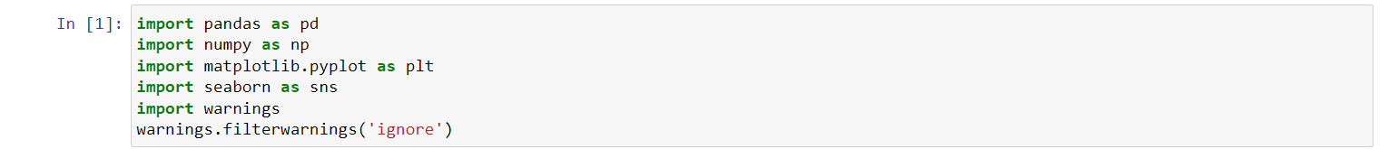
Importing the basic libraries

Slide 4
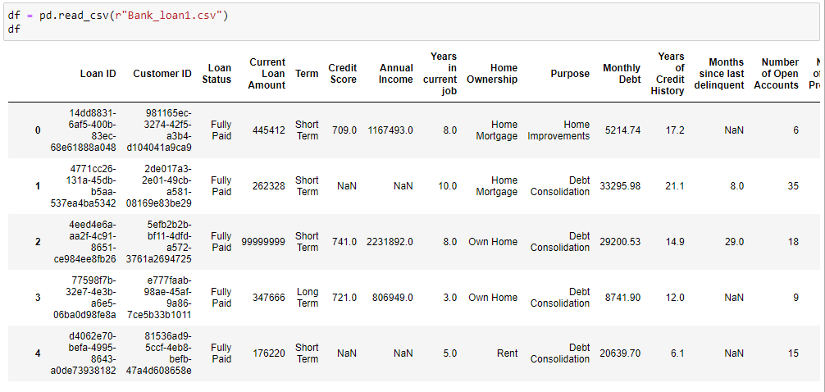
Reading the csv as Dataframe

Slide 5
features description
1 Loan ID = Unique identifier for each loan.
2 Customer ID = Unique identifier for each customer.
3 Loan Status = The status of the loan (e.g., "Fully Paid," "Charged Off," etc.)
4 Current Loan Amount = The current amount of the loan.
5 Term = The term (duration) of the loan.
6 Credit Score = The credit score of the customer.
7 Annual Income = The annual income of the customer.
8 Years in current job = The number of years the customer has been in their current job.
9 Home Ownership = The type of home ownership (e.g., "Own Home," "Mortgage," "Rent").
10 Purpose = The purpose of the loan.
11 Monthly Debt = The monthly debt payments of the customer.
12 Years of Credit History = The number of years of credit history.
13 Months since last delinquent = The number of months since the customer's last delinquency.
14 Number of Open Accounts = The number of open credit accounts the customer has.

Slide 6
EDA

Slide 7
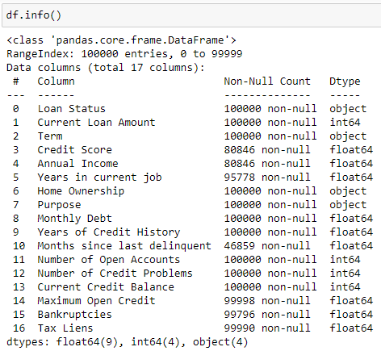
Information about the DataFrame

Slide 8
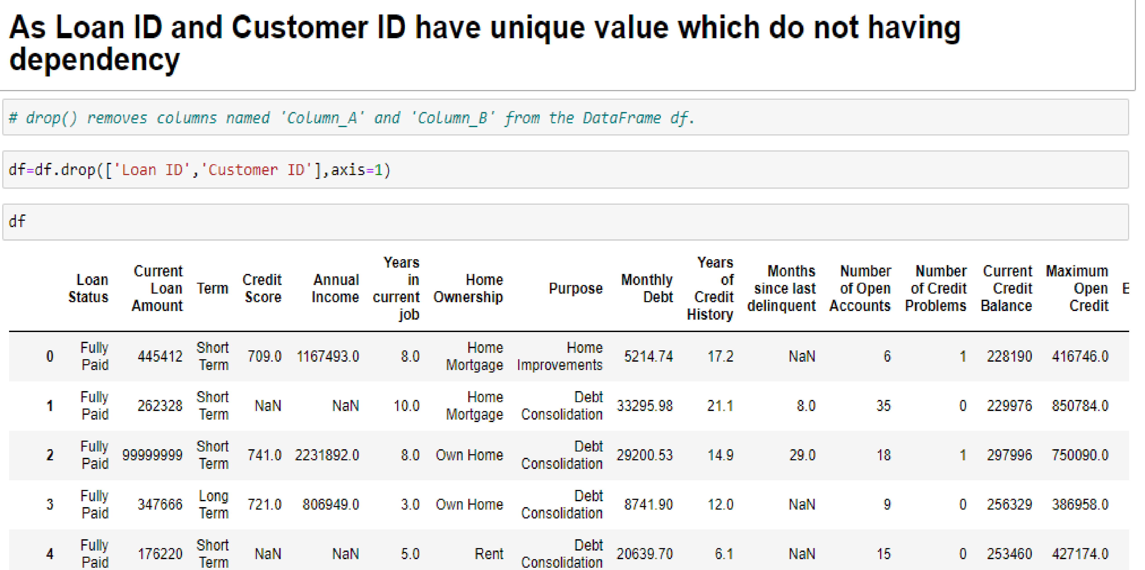
Dropping the columns

Slide 9
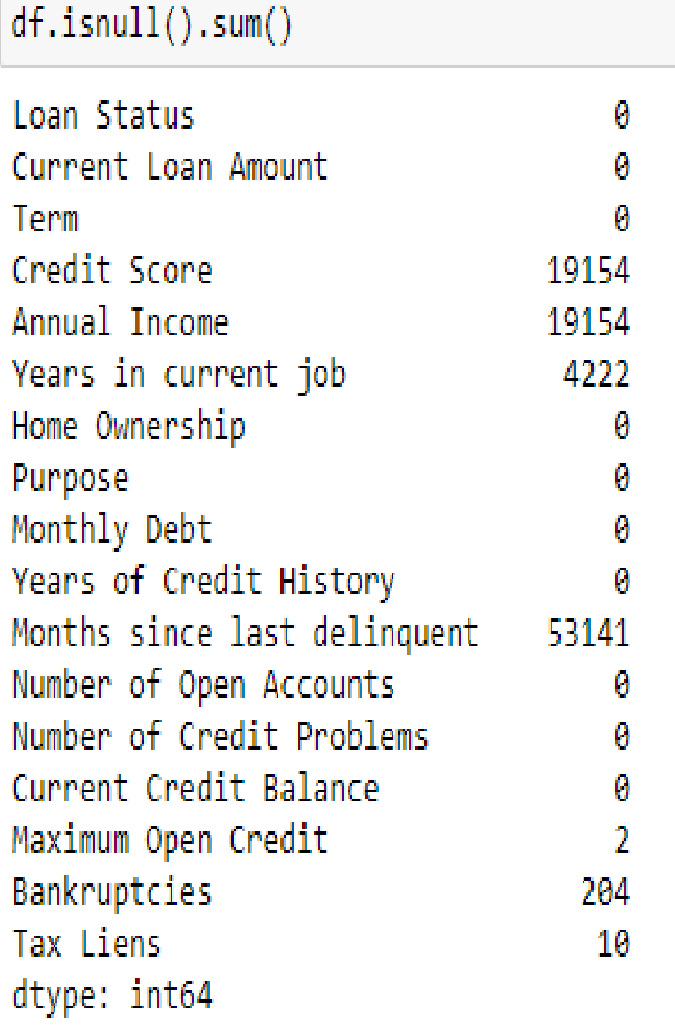
Counting the null values

Slide 10
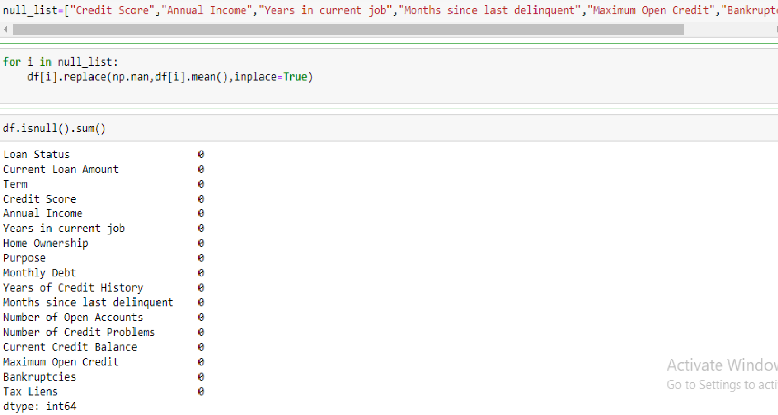
replacing null value with mean

Slide 11
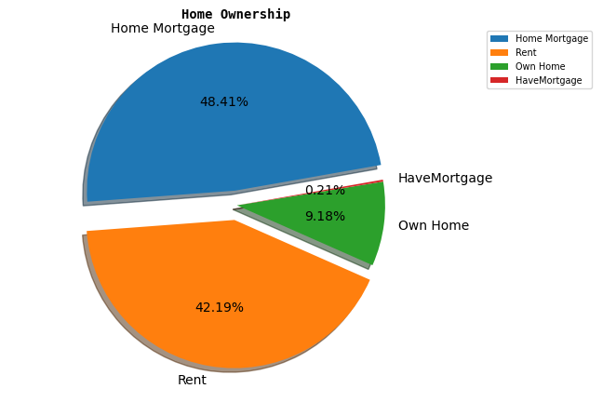
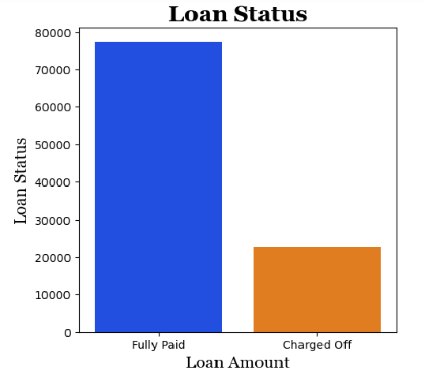
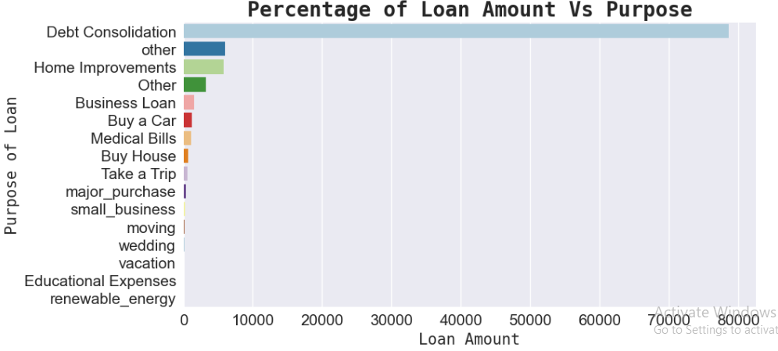
Visualizing the data

Slide 12
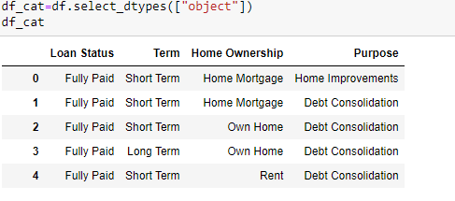
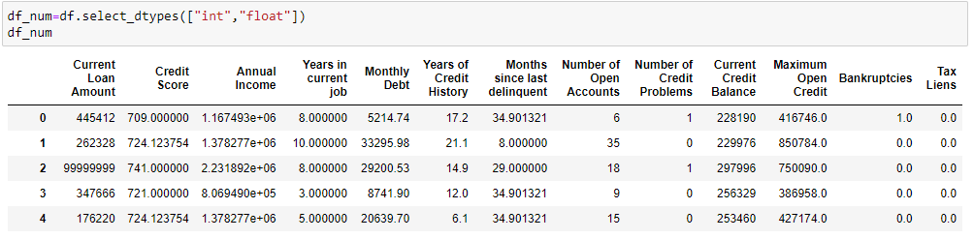
Separating Numeric and category Data

Slide 13
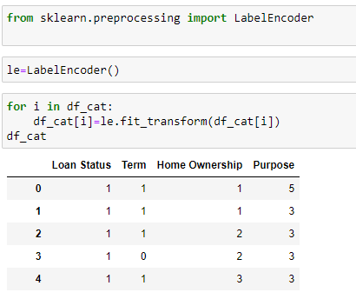
Encoding the data

Slide 14
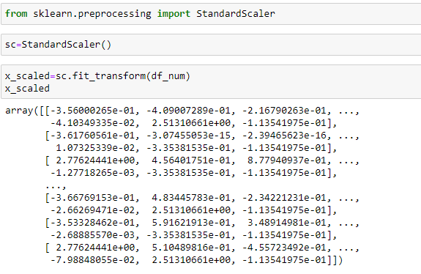
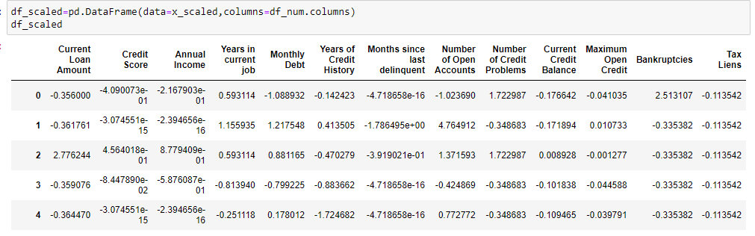
Scaling the numeric columns

Slide 15
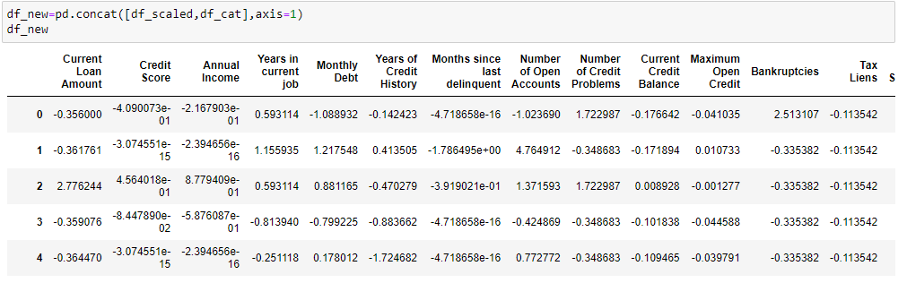
Concatenate Numerical and Categorical Columns

Slide 16
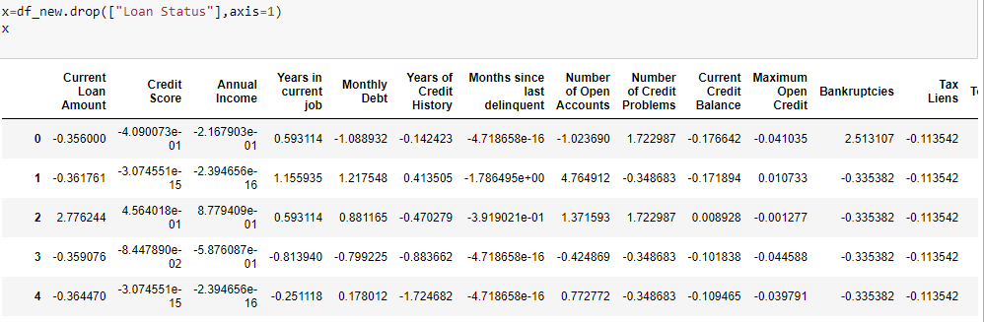
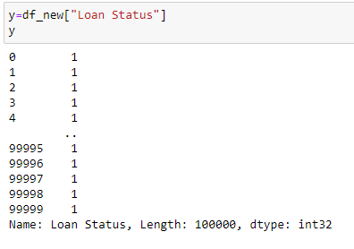
separating and assigning features and target column to x & y respectively

Slide 17
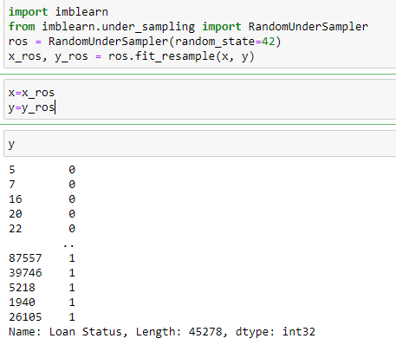
the Data is imbalanced , need to do sampling (using undersampling )

Slide 18
As now the data is converted and EDA is done moving to Machine learning

Slide 19
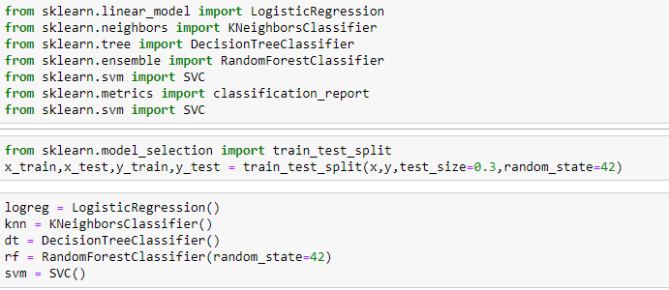
Model Evaluation

Slide 20
Model Building & Training
We build a machine learning model from features-label pairs, which comprise our training set. Our goal is to make accurate predictions for new, never-before-seen data.
There are two major types of supervised machine learning problems, called classification and regression. Our data set comes under classification problem, as the prediction of loan status.
The supervised machine learning models (classification) considered to train the dataset in this notebook are:
Logistic Regression
k-Nearest Neighbors
Decision Tree
Random Forest
SVM
The metrics considered to evaluate the model performance are Accuracy & Root Mean Squared Error.

Slide 21
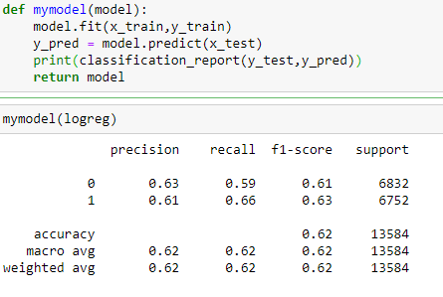
Logistic regression

Slide 22
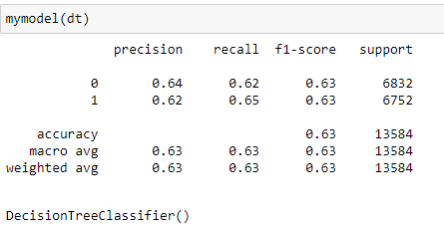
DICISION TREE

Slide 23
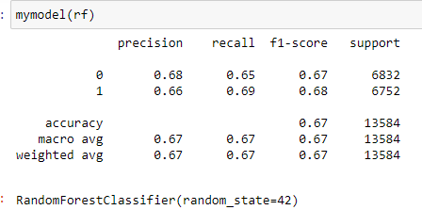
Random ForesT

Slide 24
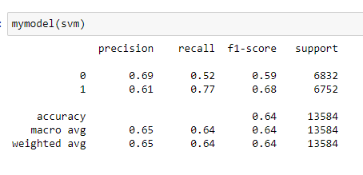
SUPPORT VECTOR MACHINE

Slide 25
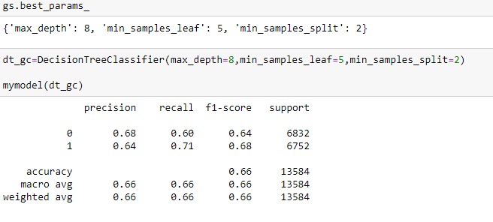
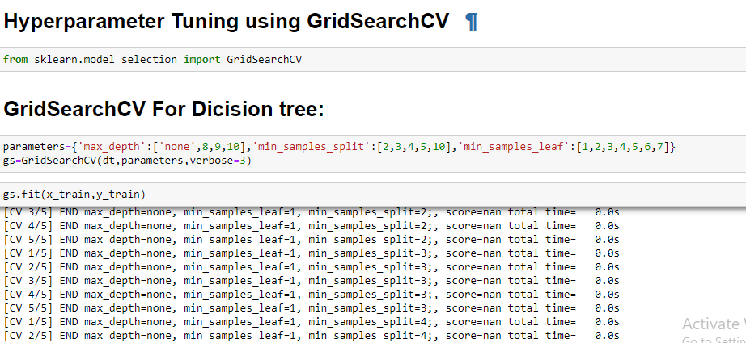
HYPERTUNE

Slide 26
Conclusion
After analyzing the dataset and implementing various machine learning algorithms, the predictive model was successfully developed. The model demonstrated robust performance in predicting loan outcomes with high accuracy, precision, and recall. Key features contributing to loan approval or denial were identified, providing valuable insights for loan approval processes. Further refinements and validations may enhance the model's performance and applicability in real-world banking scenarios.
The final conclusion on the Bank Loan Prediction is that Random forest regression is working exceptionally well with accuracy of 0.66 on the data taken as compared to other models.

Slide 27
Thank you

